Slide 1
War and Independence
Part 7-
Declaring Independence

Slide 2
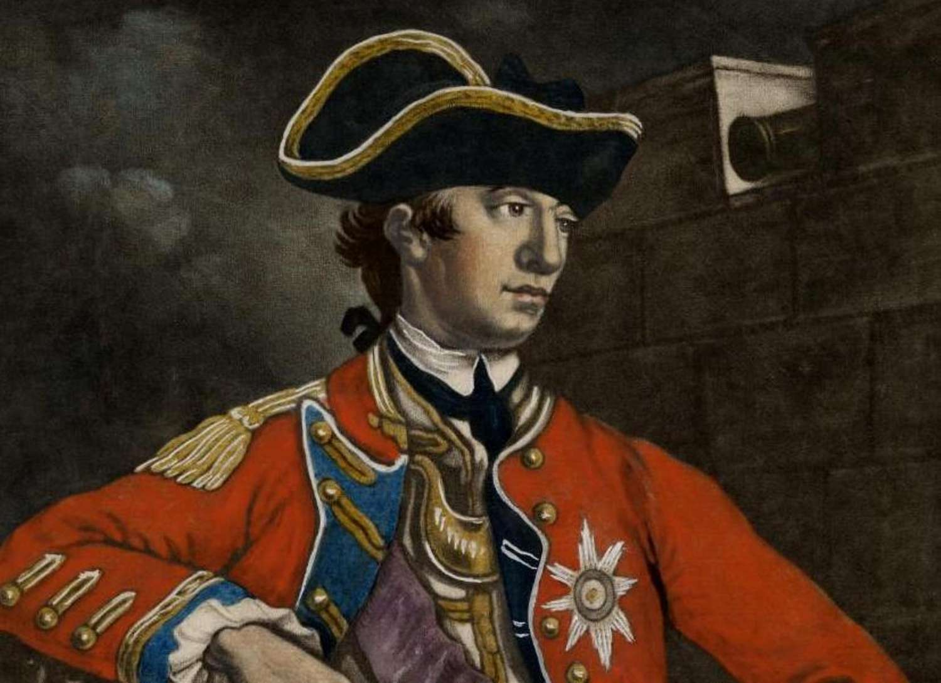
General William Howe took over command of all British troops in North America in October of 1775.

Slide 3
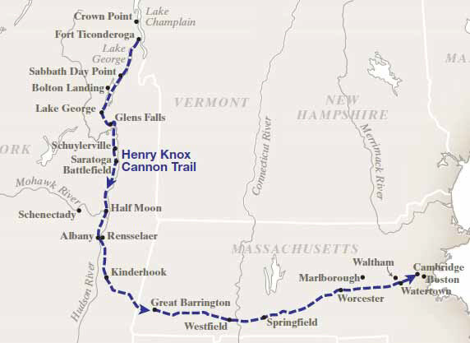
Henry Knox led an amazing expedition from Fort Ticonderoga to retrieve the 59 cannons there and bring them back the 300 miles to Boston over frozen rivers and lakes and snow-covered mountains.
Henry Knox’s Return

Slide 4
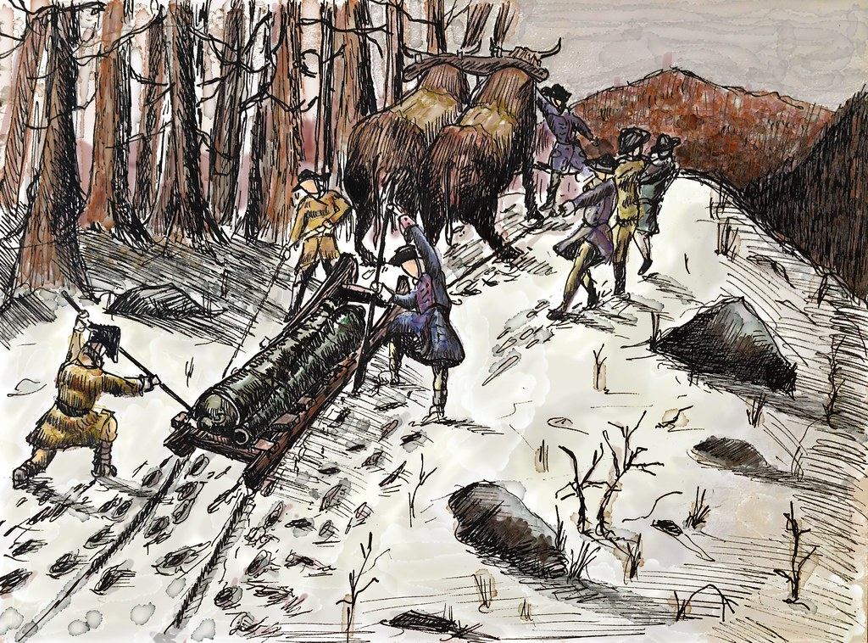
With the arrival of the cannons brought from Fort Ticonderoga by Henry Knox, George Washington was able to force the British out of Boston.

Slide 5
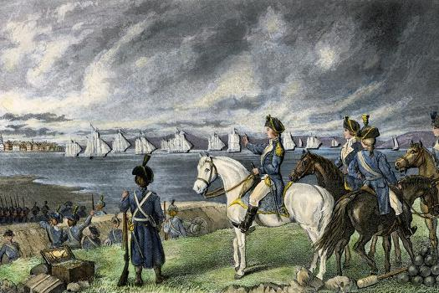
On March 17, 1776, 170 ships carried 9,000 British soldiers and 1,000 loyalists out of Boston. George Washington had his first victory in the American Revolution.

Slide 6
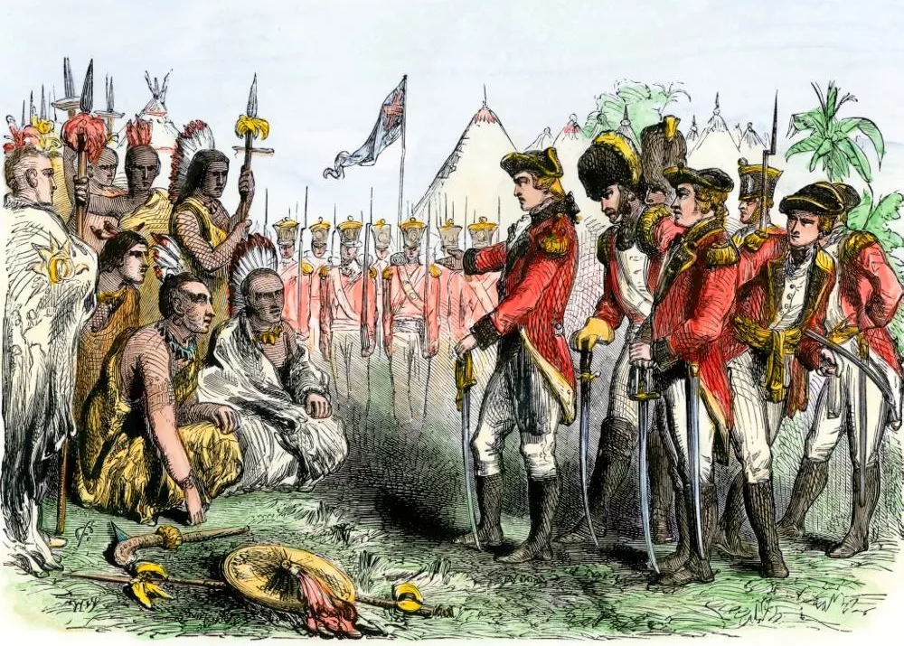
Over the next few months, there were skirmishes and small battles in North and South Carolina between Patriots and British soldier, Tories, and their Native American allies.

Slide 7
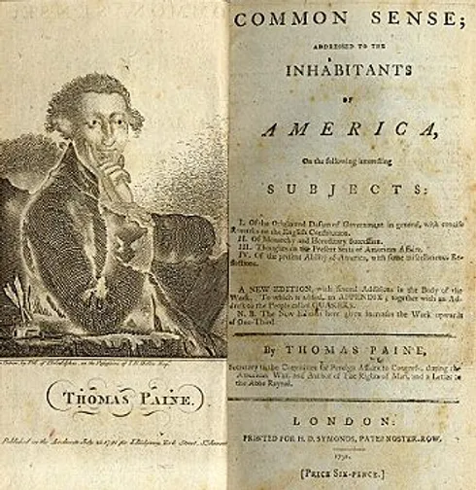
As time went on, more and more people favored independence from Great Britain.

Slide 8
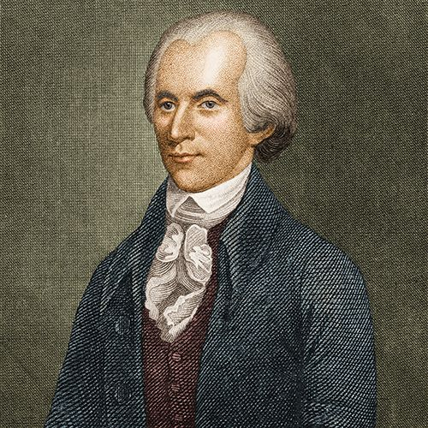
In Philadelphia, the Continental Congress was still debating what to do. In June of 1776, Richard Henry Lee of Virginia presented several resolutions (proposals) to vote on.

Slide 9
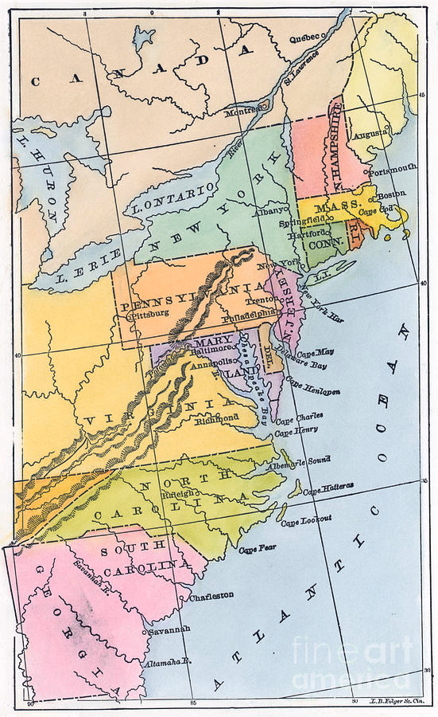
Lee’s first resolution was that the colonies should become independent states.

Slide 10
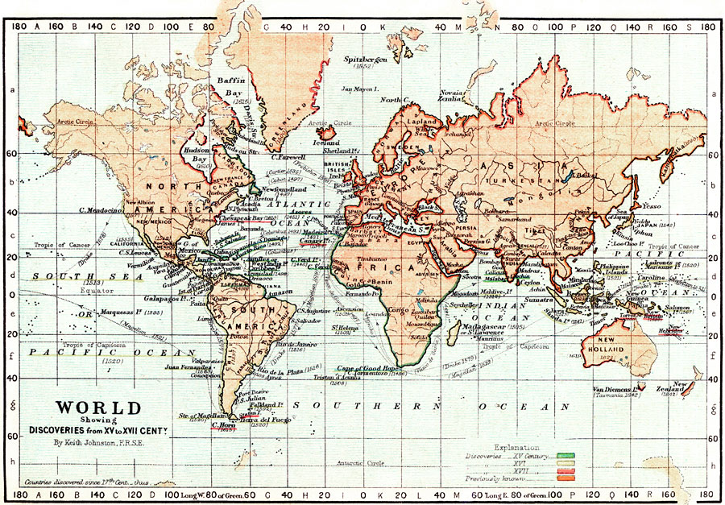
His second was that the states should take steps to form their own foreign alliances.

Slide 11
And finally, he proposed that the states should prepare a plan for joining together in a confederation.

Slide 12
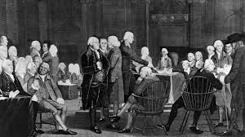
Congress organized a committee to write a Declaration of Independence.

Slide 13
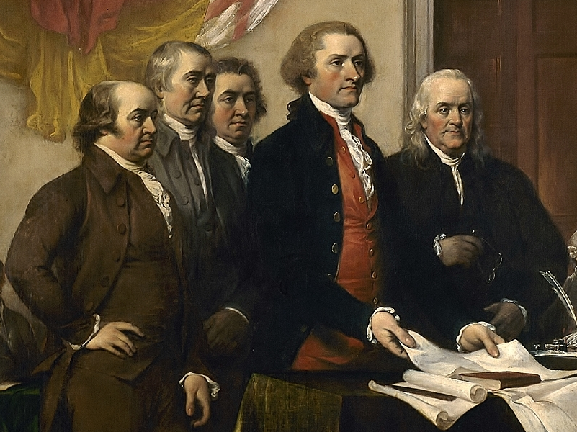
The committee included Ben Franklin, John Adams, Thomas Jefferson, Robert Livingston, and Roger Sherman. Jefferson was to write a rough draft.

Slide 14
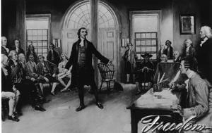
On July 1, 1776, the Continental Congress began debating Lee’s resolutions. Some delegates still wanted to work out their problems with Britain. However, when they voted on July 2nd, the Congress voted in favor of independence.

Slide 15
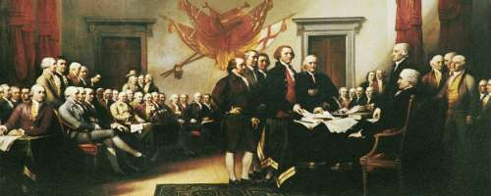
On July 4, 1776, Congress adopted the Declaration of Independence. This would be the day celebrated as the start of the United States of America.

Slide 16
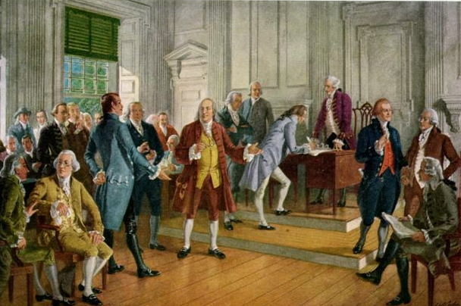
The declaration wasn’t signed by most of the 56 signers until August 2, 1776. By then many copies had been made and sent throughout the colonies…now states.

Slide 17
